Slide 1
Chapter 10
Creating a Word Document

Slide 2
Learning Objectives
Enter text
Undo and redo actions
Create documents based on existing documents
Select text
Edit text
Format text
Format paragraphs
Copy formats
Find and replace text
Check spelling and grammar
Preview and print documents

Slide 3
Entering Text
Microsoft Word 2010 is a word-processing program used to enter, edit, and change the appearance of text.
My assumption is that most of you have created and saved a Word document.
Topics Covered:
Entering Text
Inserting a Date with AutoComplete
Correcting Errors as You Type
Inserting Symbols

Slide 4
Customizing the Workspace
Before you begin or as you work on a document you can customize the way the workspace looks.
Three ways you can customize the workspace are:
Display non-print characters
Show rulers
Select zoom level

Slide 5
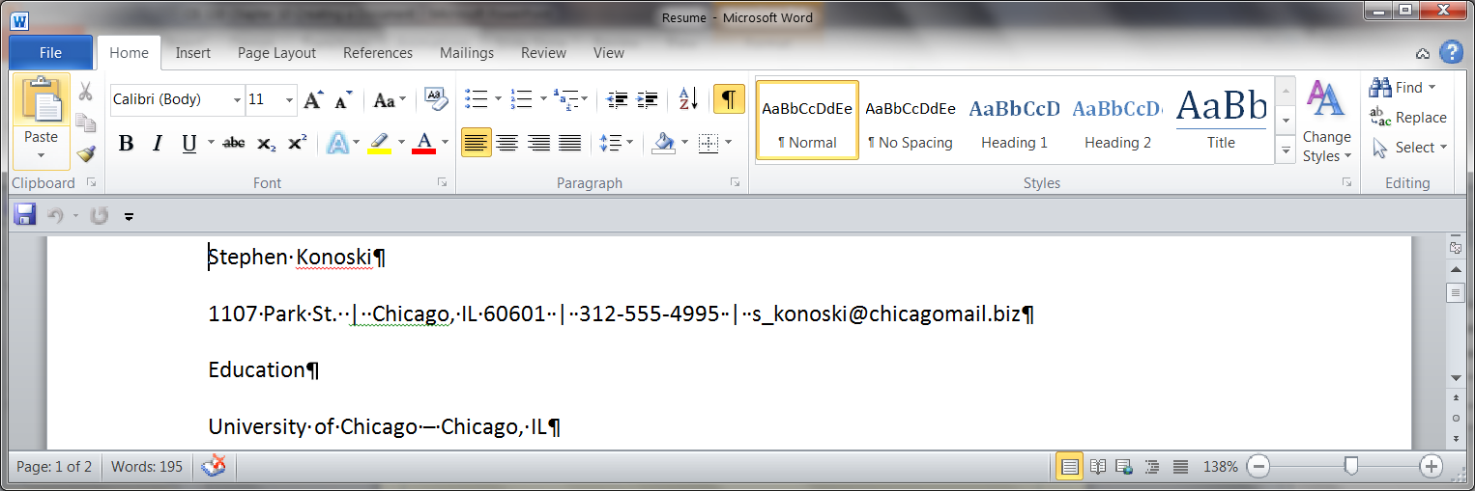
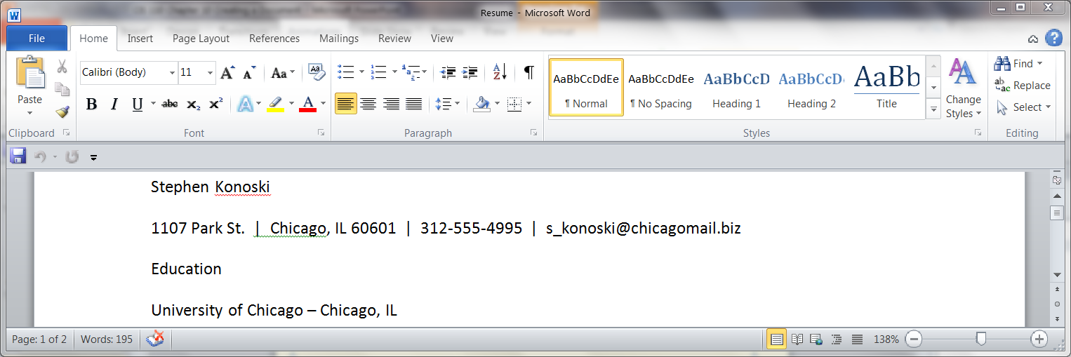
Displaying Non-print Characters
Nonprinting characters are characters that do not print and that control the way the document looks.
To Display non-print characters:
Click on the Show/Hide button
The non-print characters will appear

Slide 6
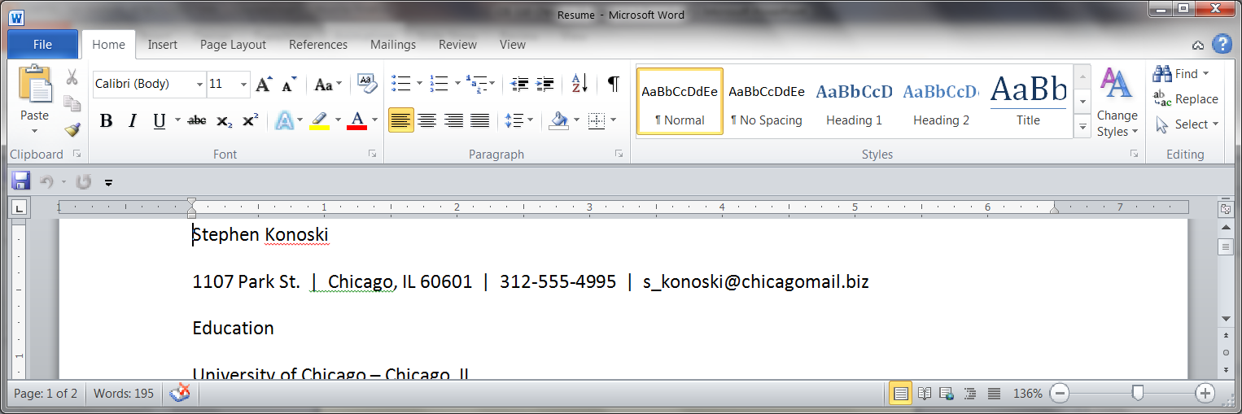
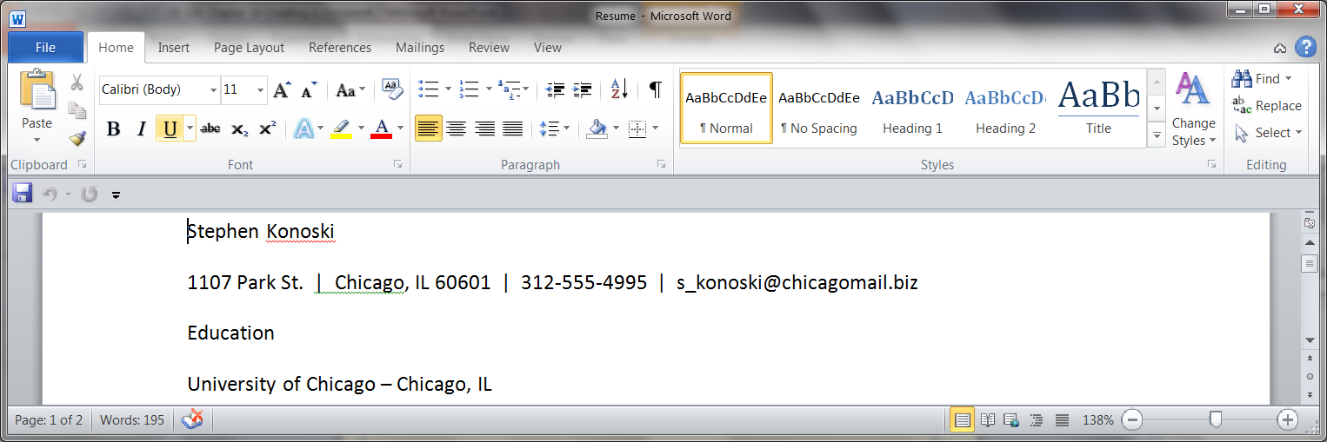
Showing Rulers
Rulers are used to help to more precisely place text and other objects in the Word document
To activate the rulers:
Click on the View Rules button
Horizontal ruler appear along the top of the workspace and a vertical ruler appear along the left side of the workspace

Slide 7

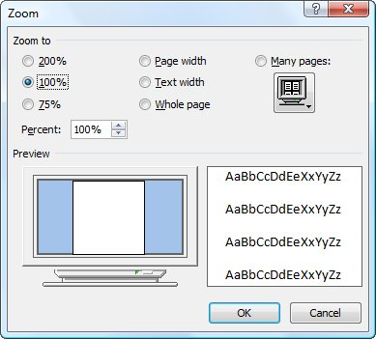
Zoom Controls
Zoom level button
Zoom out button
Zoom slider
Zoom in button
When you click on the Zoom level button the Zoom level dialog box opens

Slide 8
Saving a Files
One of the most important tasks to perform when you first create a document is to save it.
The first time you save a file, you need to name it.
This file name includes a title you specify and a file extension assigned by Office to indicate the file type.
Each file name ends with a file extension, which is a period followed by several characters that Office adds to your descriptive title to identify the program in which that file was created.

Slide 9
Entering Text
To enter text in a Word document, simply start typing.
The characters you type appear at the insertion point.
Backspace key deletes the characters and spaces to the left of the insertion point one at a time.
Delete key deletes the characters and spaces to the right of the insertion point one at a time.
Enter key creates a new paragraph.

Slide 10
Inserting a Date with AutoComplete
When you insert dates, you can take advantage of AutoComplete, a feature that automatically inserts dates and other regularly used items.

Slide 11
Correcting Errors as You Type
The AutoCorrect feature automatically corrects certain misspelled words and typing errors.
At the top of page 304 there are examples of the different corrections AutoCorrect can make.
Printed publications usually include typographic characters, which are special characters not included on the standard keyboard and that appear in professionally prepared documents.
For example, AutoCorrect changes (c) to the standard copyright symbol © as soon as you type the closing parenthesis.
At the bottom of page 303 is more extensive list of AutoCorrect typographic characters.

Slide 12
Correcting Errors as You Type
It is possible to customize AutoCorrect.
Undo the AutoCorrection
Instruct AutoCorrect to stop making a particular type of correction
See the top of page 305 for a more detailed explanation of AutoCorrect.

Slide 13

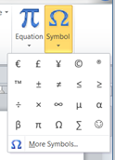
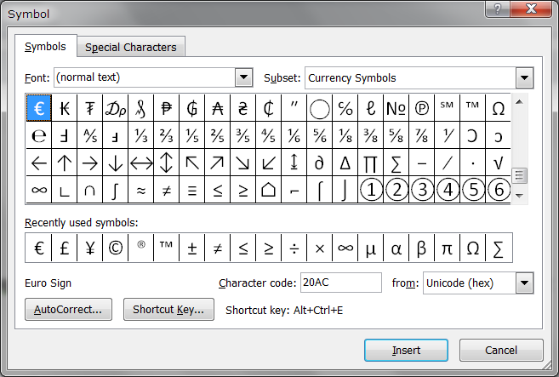
Inserting Symbols
Sometimes you will want to insert a typographic character not automatically entered with AutoCorrect.
To insert symbols use the Symbol button in the Symbols group on the Insert tab.
A standard gallery of symbols will appear.
If the symbol doesn’t appear there, click More Symbols to open the Symbol dialog box

Slide 14

Undoing and Redoing Actions
You can undo (or reverse) the last thing you did in a document.
To do this, click the Undo button on the Quick Access Toolbar.
To redo, or restore your original change, use the Redo button, which reverses the action of the undo button (or redoes the undo).
Undo button
Redo button
Key Combination
Ctrl + z
Key Combination
Ctrl + y

Slide 15
Creating Documents Based on Existing Documents
Topics Covered:
Using the Save As Command
Using the New from Existing Command

Slide 16
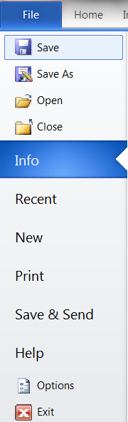
Using the Save As Command
When you open a document and then save it with a new name, you create a copy of the original document.
To access the Save As command
Click on the File tab
Click on the save As command.
The Save As dialog box will open.

Slide 17
Using the New from Existing Command
You will practice the following explanations by doing the activities beginning with the section “Creating Documents Based on Existing Documents” starting on page 307 in the textbook.
Another way to create a copy of a document is to use the New from existing command.
Unlike using the Save As command, where you open the original document and then create a copy by saving it with a new name, the New from existing command opens a copy of the document as a new document.

Slide 18
Using Temples
You can also use a template as your starting point.
A file that contains instructions for changing the appearance of text and graphics, and often sample content, to guide you as your develop your own content.
Found on New tab in Backstage view or on Office.com.

Slide 19
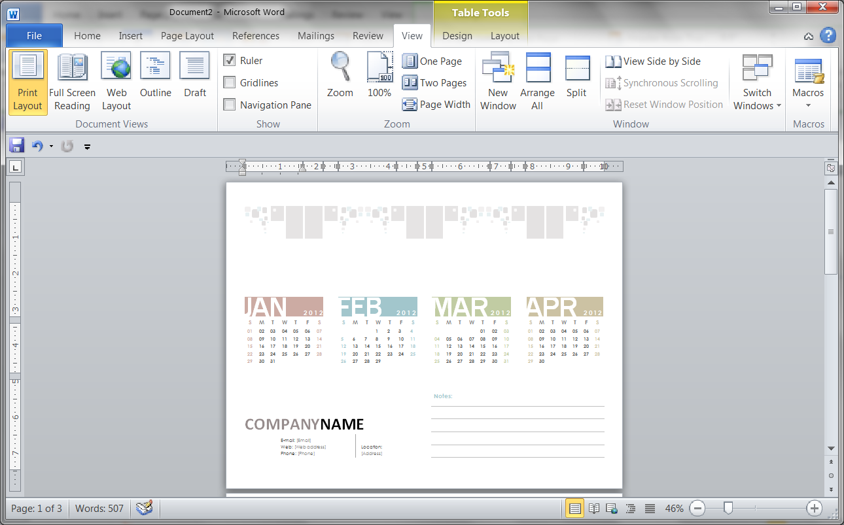
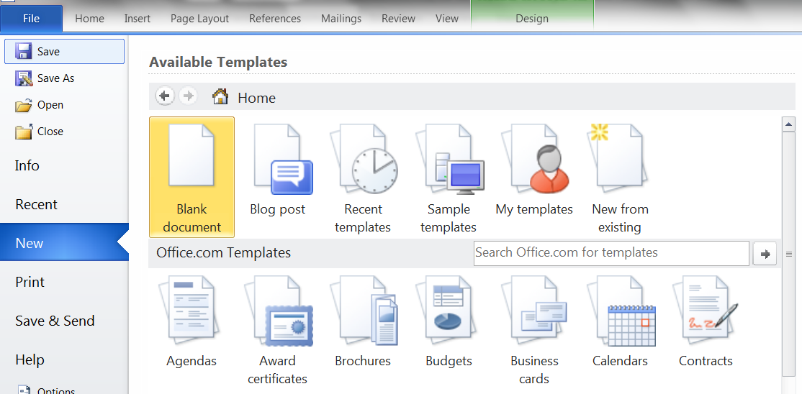
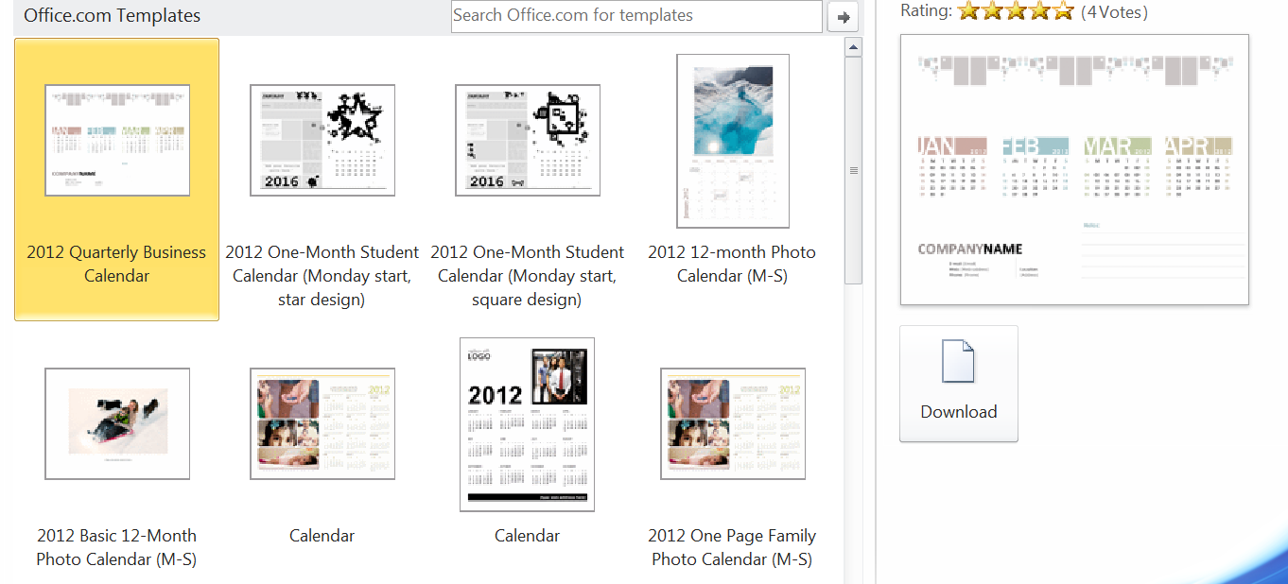
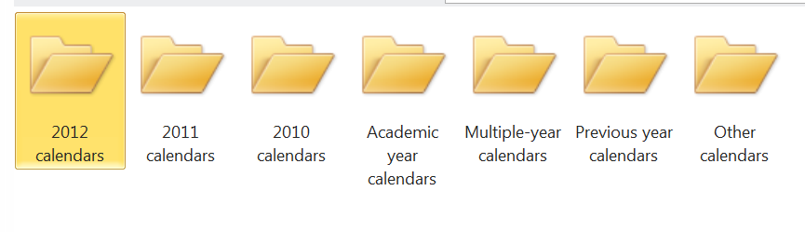
Using Temples

Slide 20
Selecting Text
To select text with the mouse:
Press and hold the mouse button, drag across a block of text, and then release the mouse button
Double-click to select a single word
Triple-click to select a paragraph of text
Or position the pointer in the selection bar—the white space in the left margin—so that the pointer changes to an arrow, and then click or drag.
Use the Ctrl + a key combination to select all of the text in a document.

Slide 21
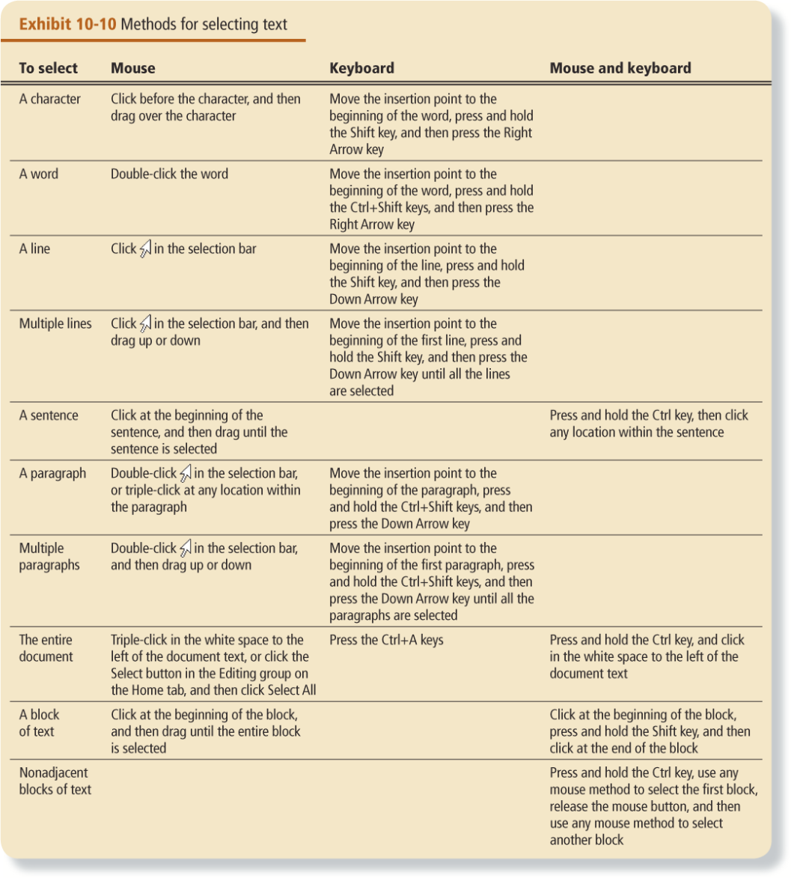
Selecting Text
On page 310 of the book is a detailed table of selecting text options.

Slide 22
Editing Text
Topics Covered:
Replacing Selected Text
Using Drag and Drop

Slide 23
Replacing Selected Text
To replace existing text, you select the text you no longer want, and then start typing.
The insertion point indicates where text will be inserted in the document.

Slide 24
Using Drag and Drop
To use drag and drop to move text
select the text you want to move
press and hold the mouse button
drag the selected text to a new location
release the mouse button.
Unlike the Cut or Copy commands, when you drag and drop, the text you drag is not placed on the Clipboard.

Slide 25
Formatting Text
Once you have entered the text of a document, you can change how it looks – that is, you can format the document.
The purpose of formatting is to make the document attractive, emphasize certain points in the document, and make the organization and flow of the document clear to readers
Topics Covered:
Changing the Font and Font Size
Changing Font Styles
Changing Text Color

Slide 26
Changing the Font and Font Size
A font is the design of a set of characters.
Fonts are measured in points, which are units of measurement.

Slide 27
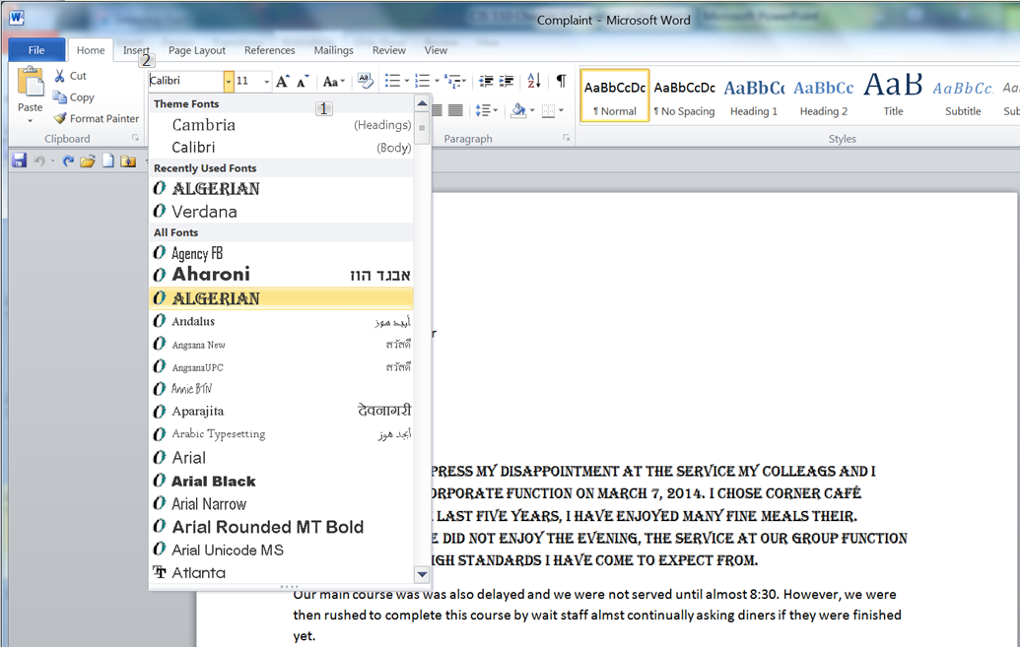
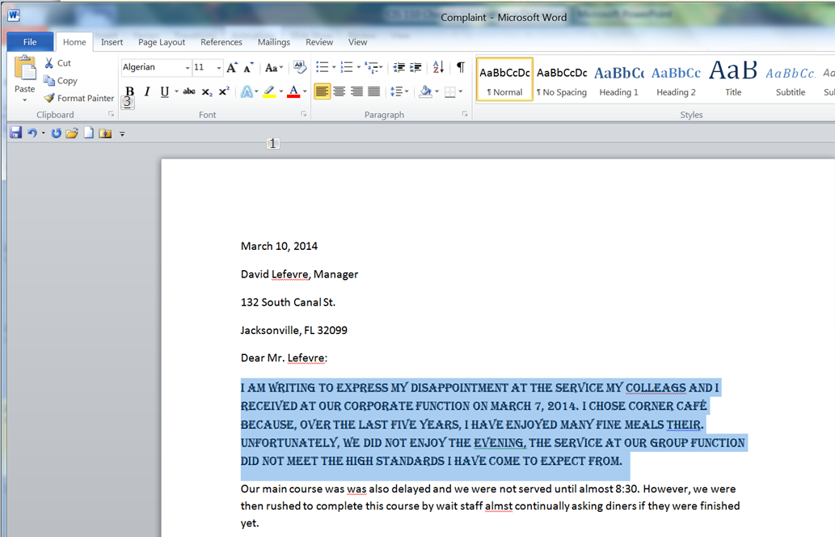
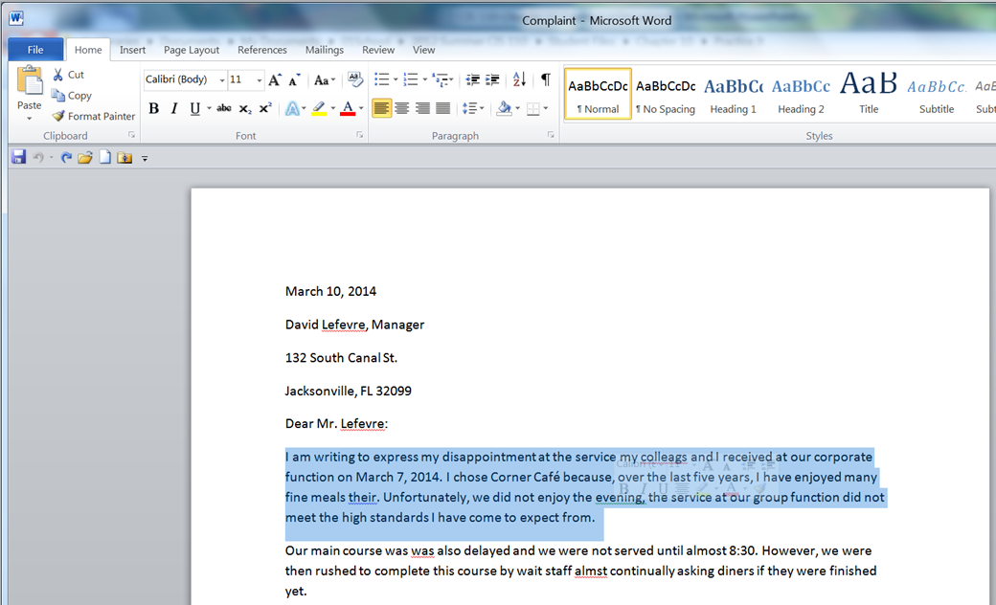
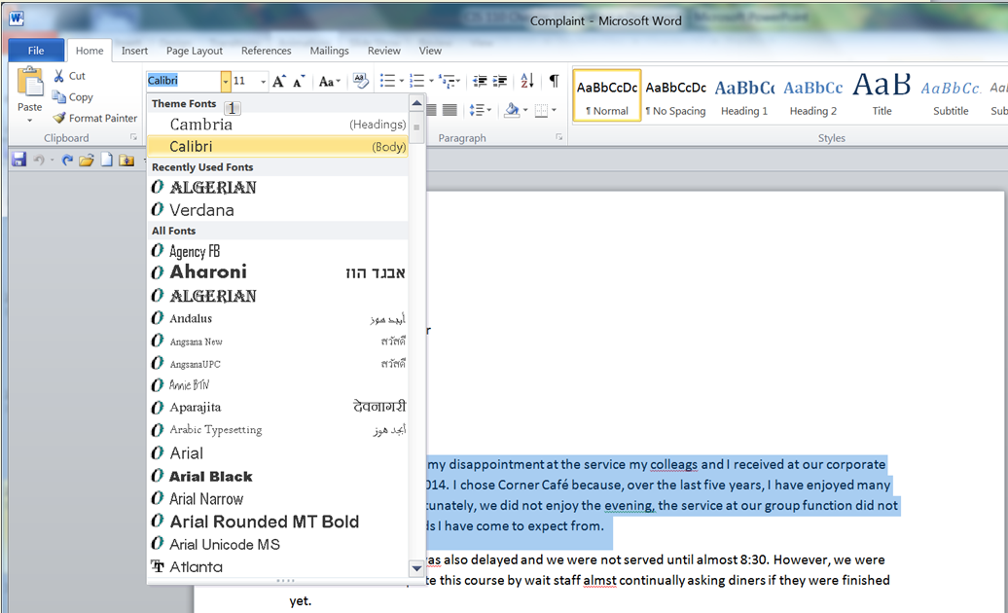
Changing the Font

Slide 28
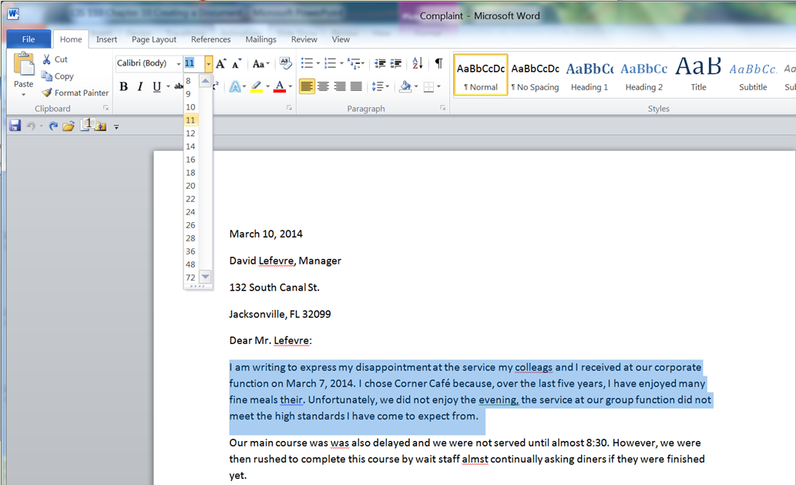
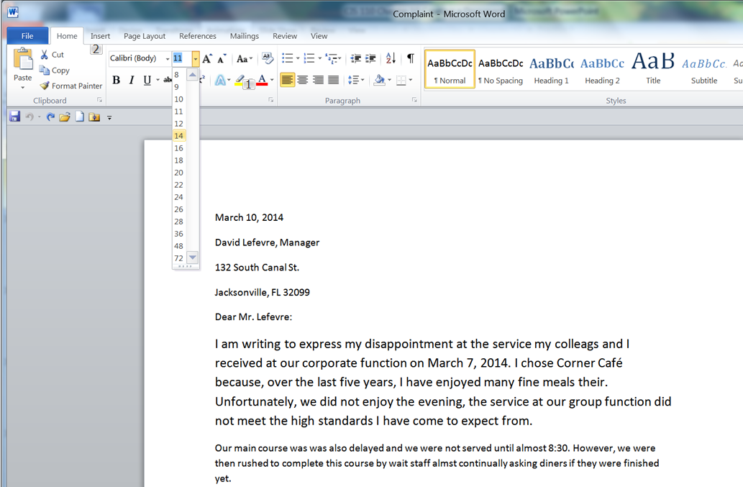
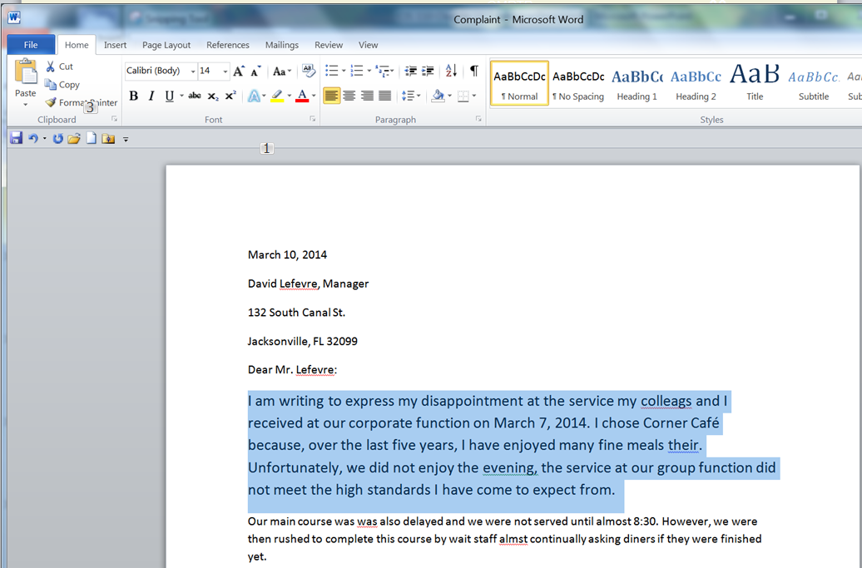
Changing the Font Size

Slide 29







Changing Font Styles
Font style refers to format attributes applied to text, such as bold and italics.
Sample text
Sample text
Sample text
Sample text
Sample text
Sample
text
Sample
text

Slide 30
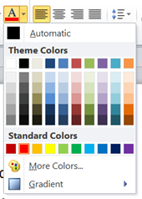
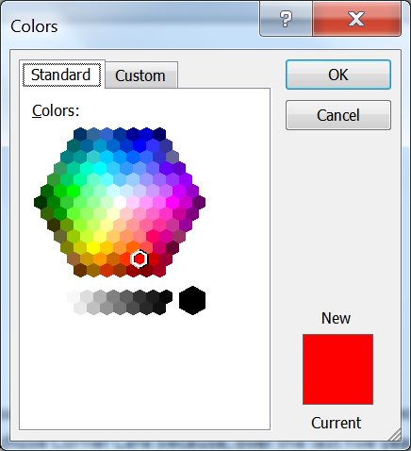


Changing Text Color
Judicious use of color makes headings or other important text stand out.

Slide 31
Formatting Paragraphs
Topics Covered:
Adjusting Paragraph Spacing
Adjusting Line Spacing
Aligning Paragraphs
Using Tabs
Creating Bulleted and Numbered Lists
Adding a Paragraph Border
Adding Paragraph Shading
Indenting a Paragraph

Slide 32
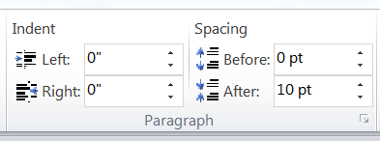
Adjusting Paragraph Spacing
Paragraph spacing refers to the space that appears directly above and below a paragraph.
Paragraph spacing is found on the Page layout tab.
Note that the preset for paragraph spacing is 0 pt before and 10 pt after

Slide 33
Adjusting Line Spacing
Line spacing is the amount of space that appears between lines of text within a paragraph.
Paragraphs formatted with the 1.0 setting are called single spaced.
Paragraphs formatted with the 2.0 setting are called double spaced and have a blank line of space between each line of text in the paragraph.

Slide 34
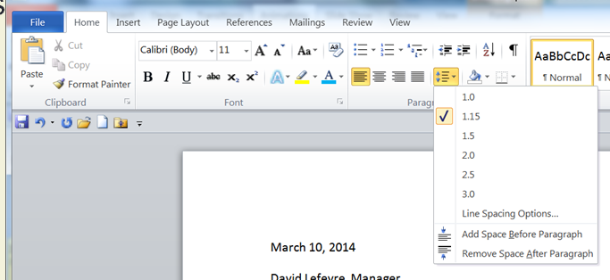
Adjusting Line Spacing
Line spacing is found on the Home tab

Slide 35
Aligning Paragraphs
Normal paragraphs are left-aligned—they are flush with the left margin and ragged, or uneven, along the right margin.
Right-aligned paragraphs are aligned along the right margin and ragged along the left margin.
Paragraphs that are centered are positioned midway between the left and right margins and ragged along both margins.
Justified paragraphs are flush with both the left and right margins.

Slide 36

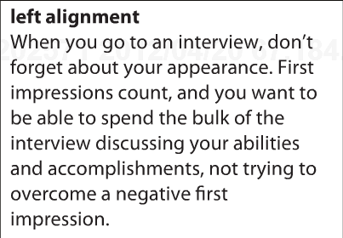
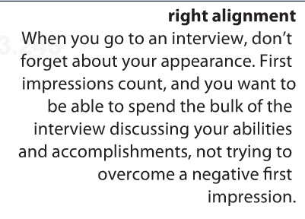


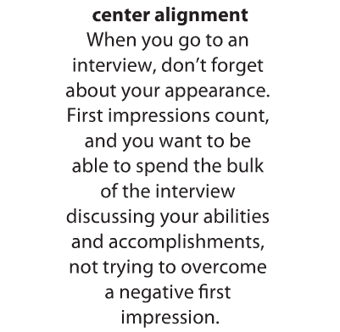
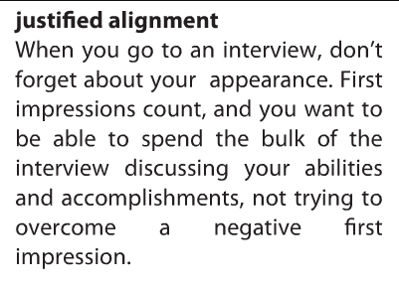

Aligning Paragraphs
Paragraph allignment is found on the Home tab

Slide 37
Using Tabs
Tab stops are useful for aligning small amounts of data in columns.
When you press the Tab key, the insertion point moves to the next tab stop to the right.

Slide 38
Creating Bulleted and Numbered Lists
A bulleted list is a group of related paragraphs with a symbol, such as a dot, dash, or other character, that appears to the left of each paragraph.
For a group of related paragraphs that have a particular order (such as steps in a procedure), you can use numbers instead of bullets to create a numbered list.

Slide 39
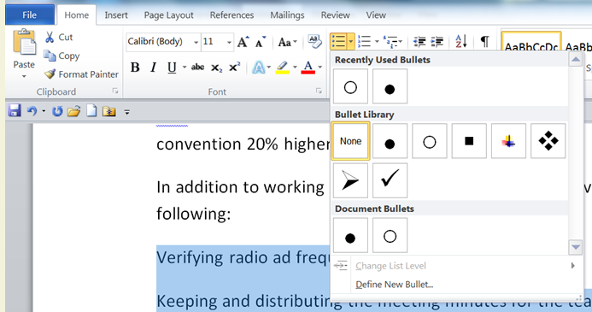
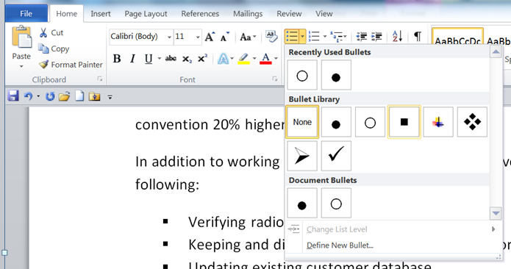
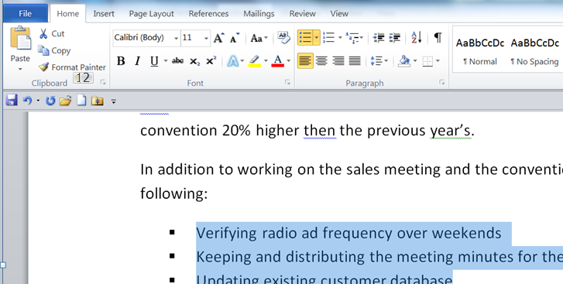
Creating Bulleted Lists

Slide 40
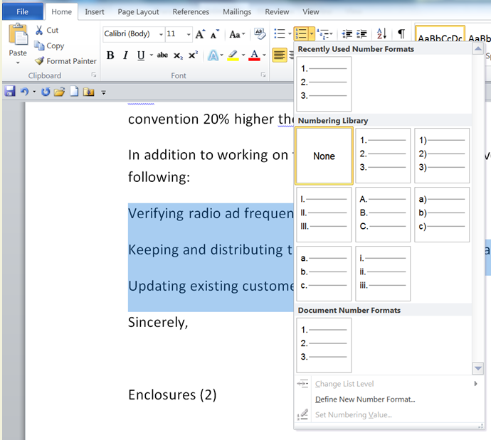
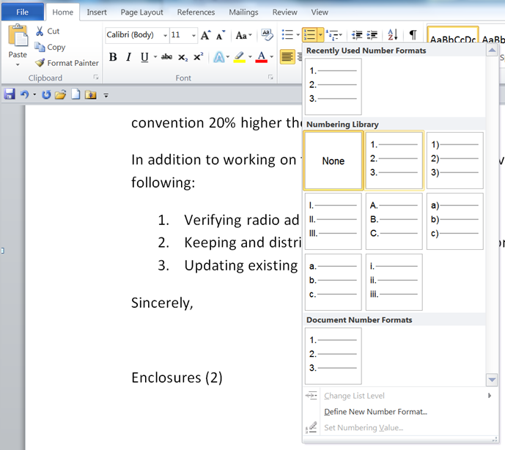
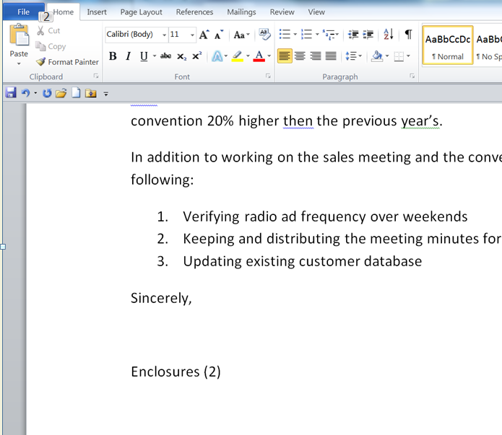
Creating Numbered Lists

Slide 41
Creating Bulleted Lists as You Type
To create a bulleted list as you type
Click the Bullets button in the Paragraph group on the Home tab
Type the first item in the list
Press the Enter key
The bullet will appear before the next paragraph

Slide 42
Creating Number Lists as You Type
To create a number list as you type
Click the Number button in the Paragraph group on the Home tab
Type the first item in the list
Press the Enter key
The numbers will appear before the next paragraph
You can use the Auto-correct
type the number 1 followed by a period
press the Tab key.
AutoCorrect formats the paragraph as the first item in a numbered list and the Numbering button in the Paragraph group on the Home tab is selected.

Slide 43
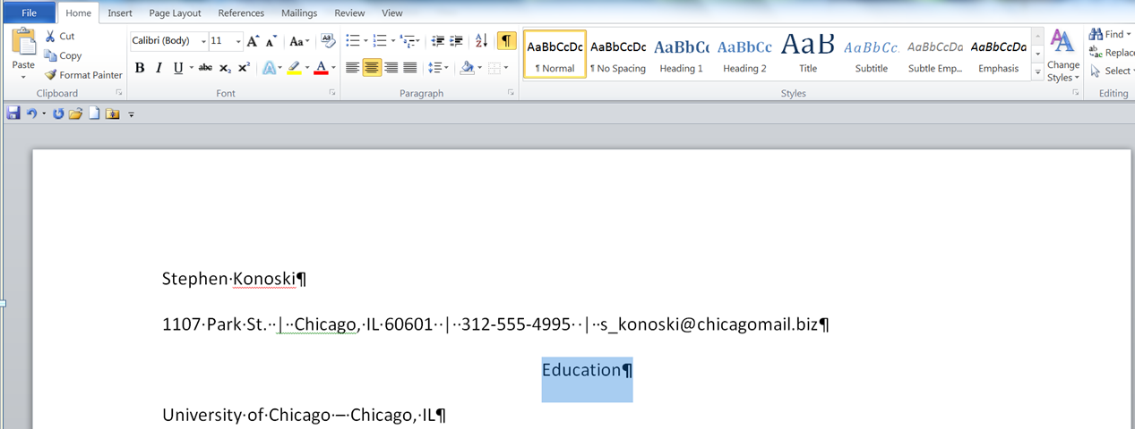
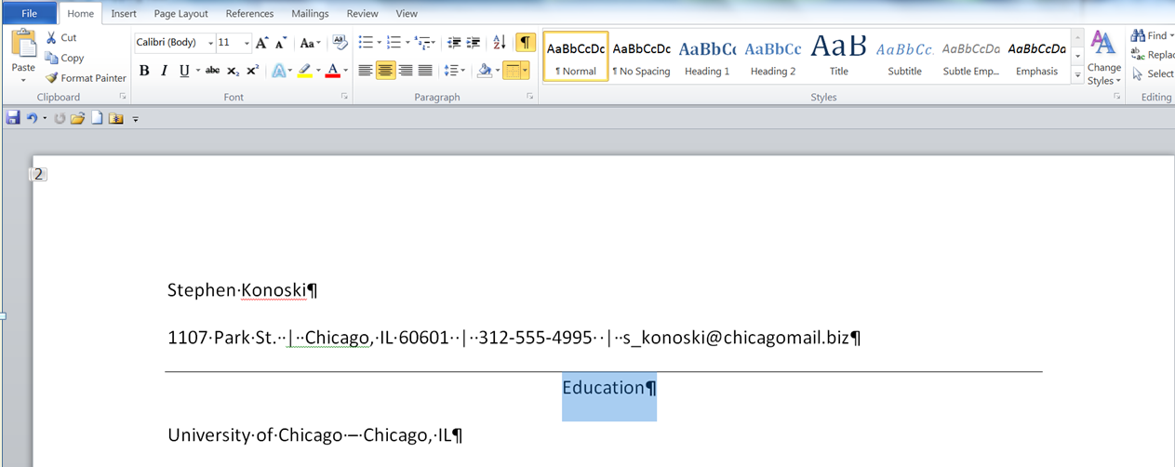
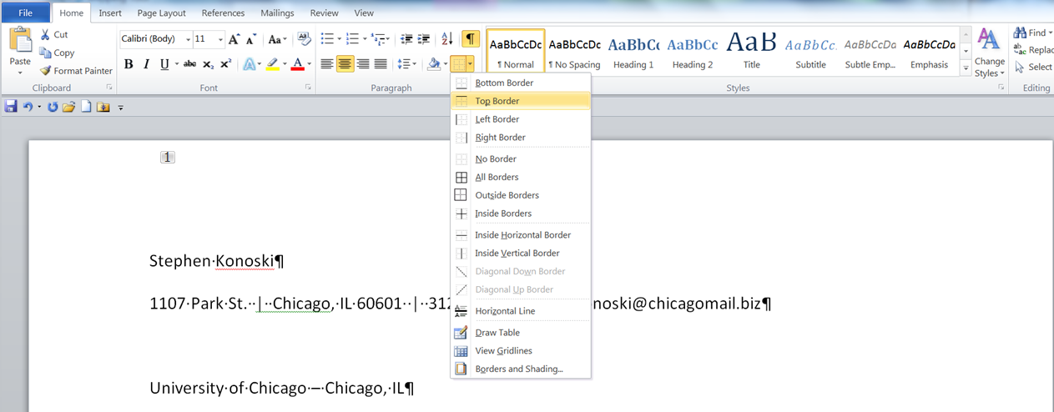
Adding a Paragraph Border
A paragraph border is an outline that appears around one or more paragraphs in a document.
Note that no preview appears when you hover over a boarder style

Slide 44
Adding Paragraph Shading
You can add shading as background color to one or more paragraphs.
To apply shading, use the Shading button in the Paragraph group on the Home tab.

Slide 45
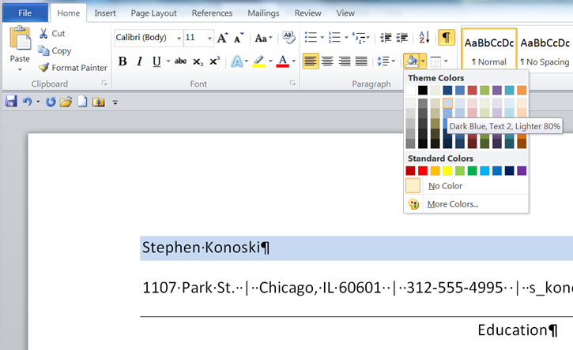
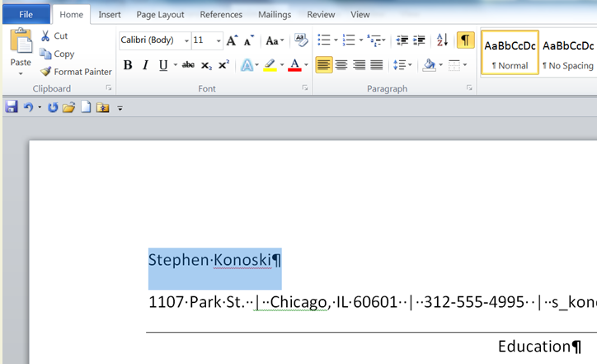
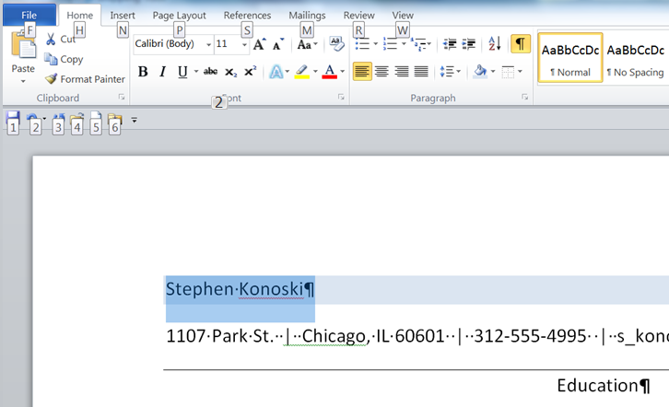
Adding Paragraph Shading

Slide 46
Indenting a Paragraph
Word offers a number of options for indenting a paragraph.
A first-line indent shifts the first line of a paragraph from the left margin
A hanging indent shifts all the lines of a paragraph from the left margin except the first line.

Slide 47

Indenting a Paragraph
First Line Indent Marker
Left Indent Marker

Slide 48
Copying Formats
Topics Covered:
Using the Format Painter
Using Paste Options

Slide 49
Using the Format Painter
The Format Painter is a tool that allows you to copy formatting from one location to another, such as from one paragraph of text to another.

Slide 50
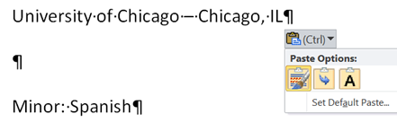
Using Paste Options
When you paste text in Word, a Paste Options button appears below the lower-right corner of the pasted text.
You can click this button to open a menu with buttons that control the formatting of the pasted text.
Merge Formatting
Keep Text
Only
Use Destination Theme

Slide 51
Finding and Replacing Text
Topics Covered:
Finding Text
Replacing Specific Text

Slide 52
Finding Text
To find specific text in a document, first open the Navigation Pane by clicking the Find button in the Editing group on the Home tab.
Then, in the Search Document box in the Navigation Pane, type the text for which you are searching.
As you type, Word highlights every instance of the search text in the document, and a list of text snippets containing each instance of the search text appears in the Navigation Pane.

Slide 53
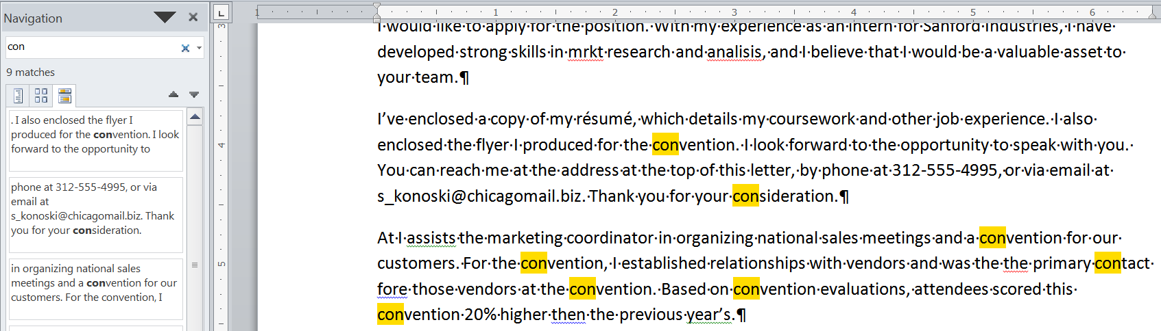
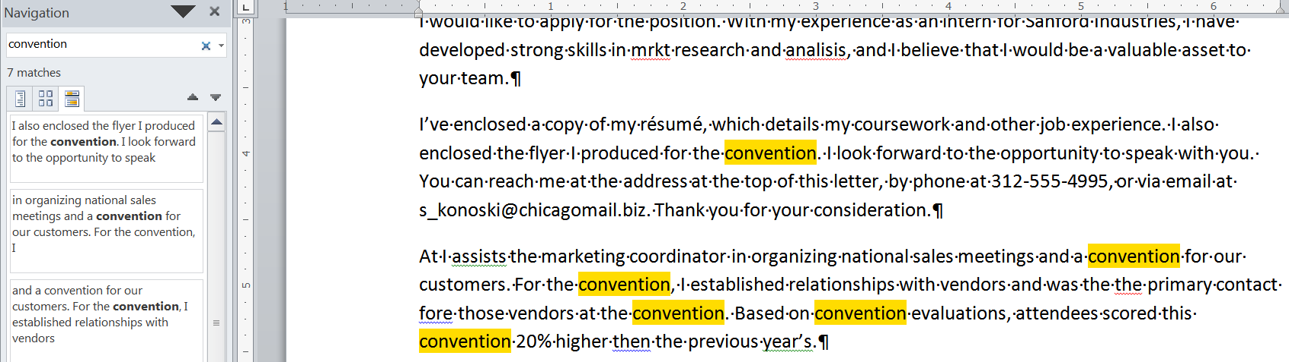
Finding Text

Slide 54
Replacing Specific Text
You can replace specific text using the Find and Replace dialog box, which you open by clicking the Replace button in the Editing group on the Home tab.
Be careful when you use the Replace All Command.

Slide 55
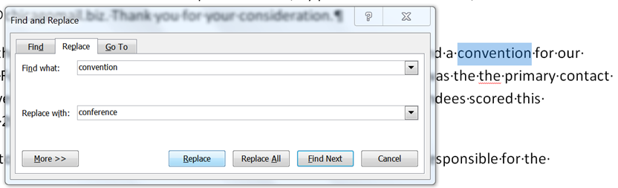
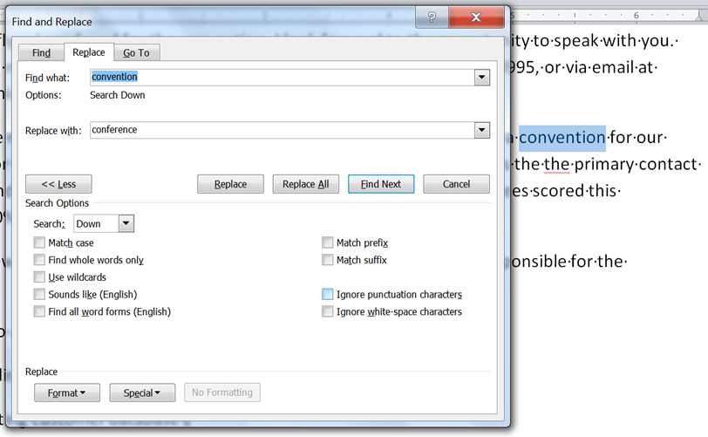
Replacing Specific Text

Slide 56
Checking Spelling and Grammar
Topics Covered:
Checking Flagged Words Individually
Checking the Spelling in the Entire Document

Slide 57
Checking Flagged Words Individually
You can right-click a word flagged with a red wavy underline to open a shortcut menu containing suggestions for alternate spellings
as well as commands for ignoring the misspelled word
You can right-click a word flagged with a green wavy underline to correction for a grammatical error

Slide 58
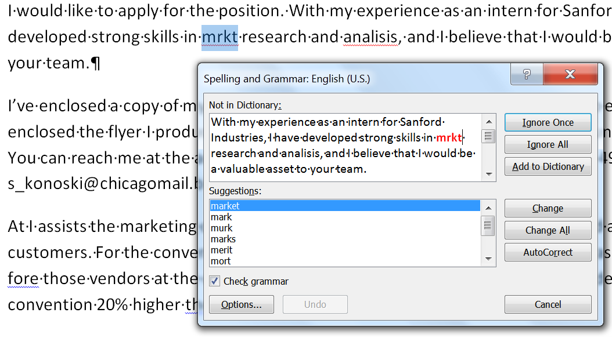
Checking the Spelling in the Entire Document
To spell-check the entire document, click the Spelling & Grammar button in the Proofing group on the Review tab.
The advantage to using this method is that you will never miss a misspelling or grammar problem in the document.

Slide 59
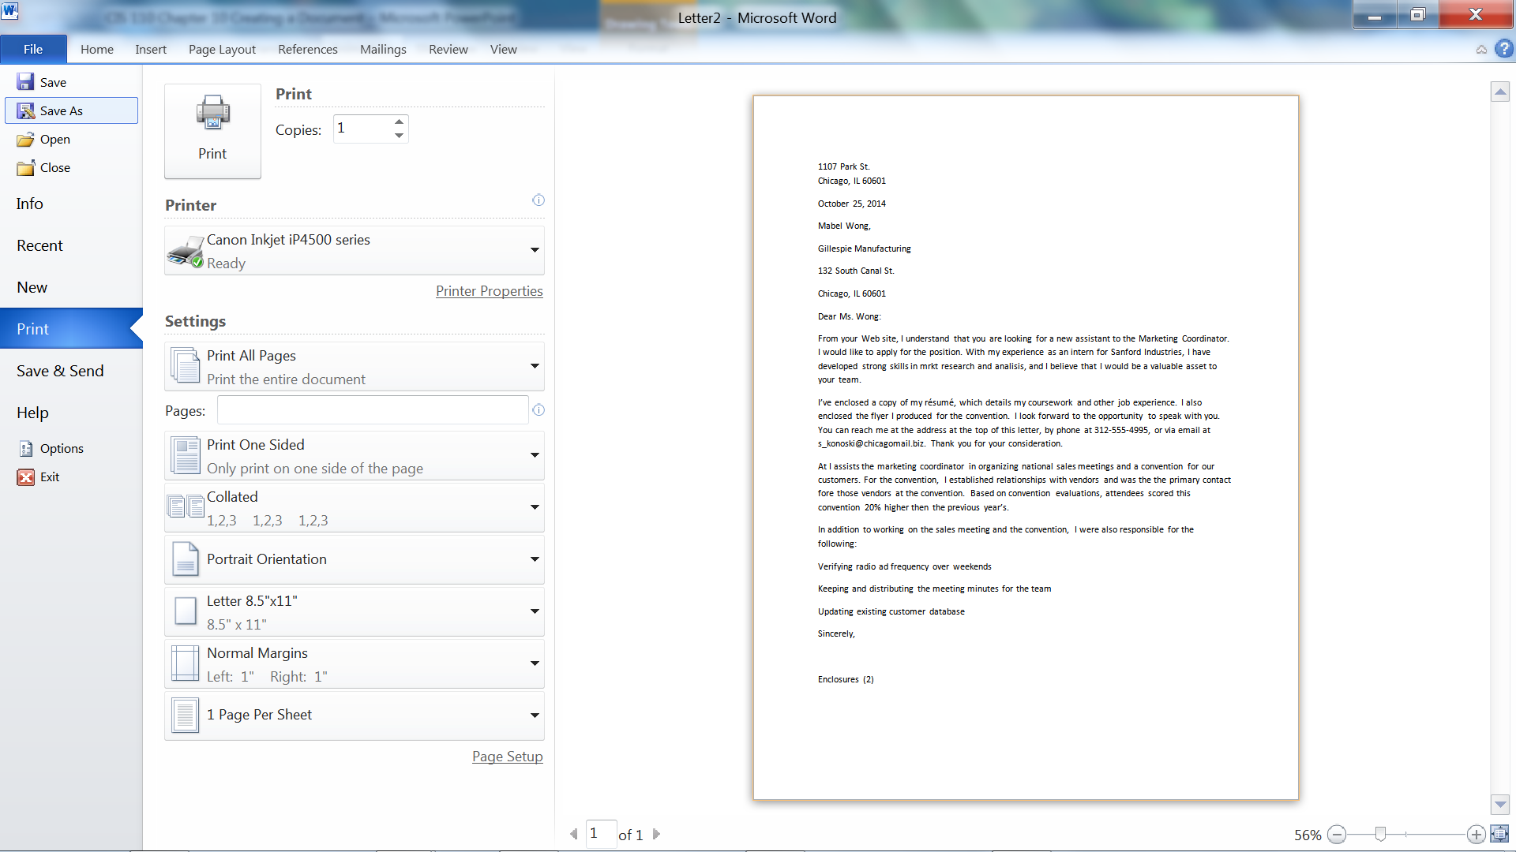
Previewing and Printing Documents

